Slide 1
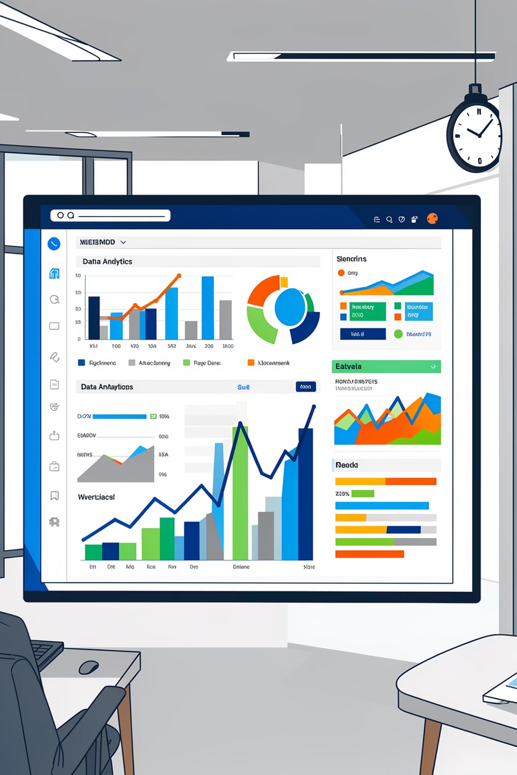
Customer Shopping Behavior Analysis
Uncovering insights from 3,900 purchases to drive strategic decisions

Slide 2

DATASET OVERVIEW
The Foundation
3.9K
18
4
Total Purchases
Data Points
Categories
Transactions analyzed
Features per transaction
Product segments
Demographics, purchase details, and shopping behavior across clothing, accessories, footwear, and outerwear

Slide 3
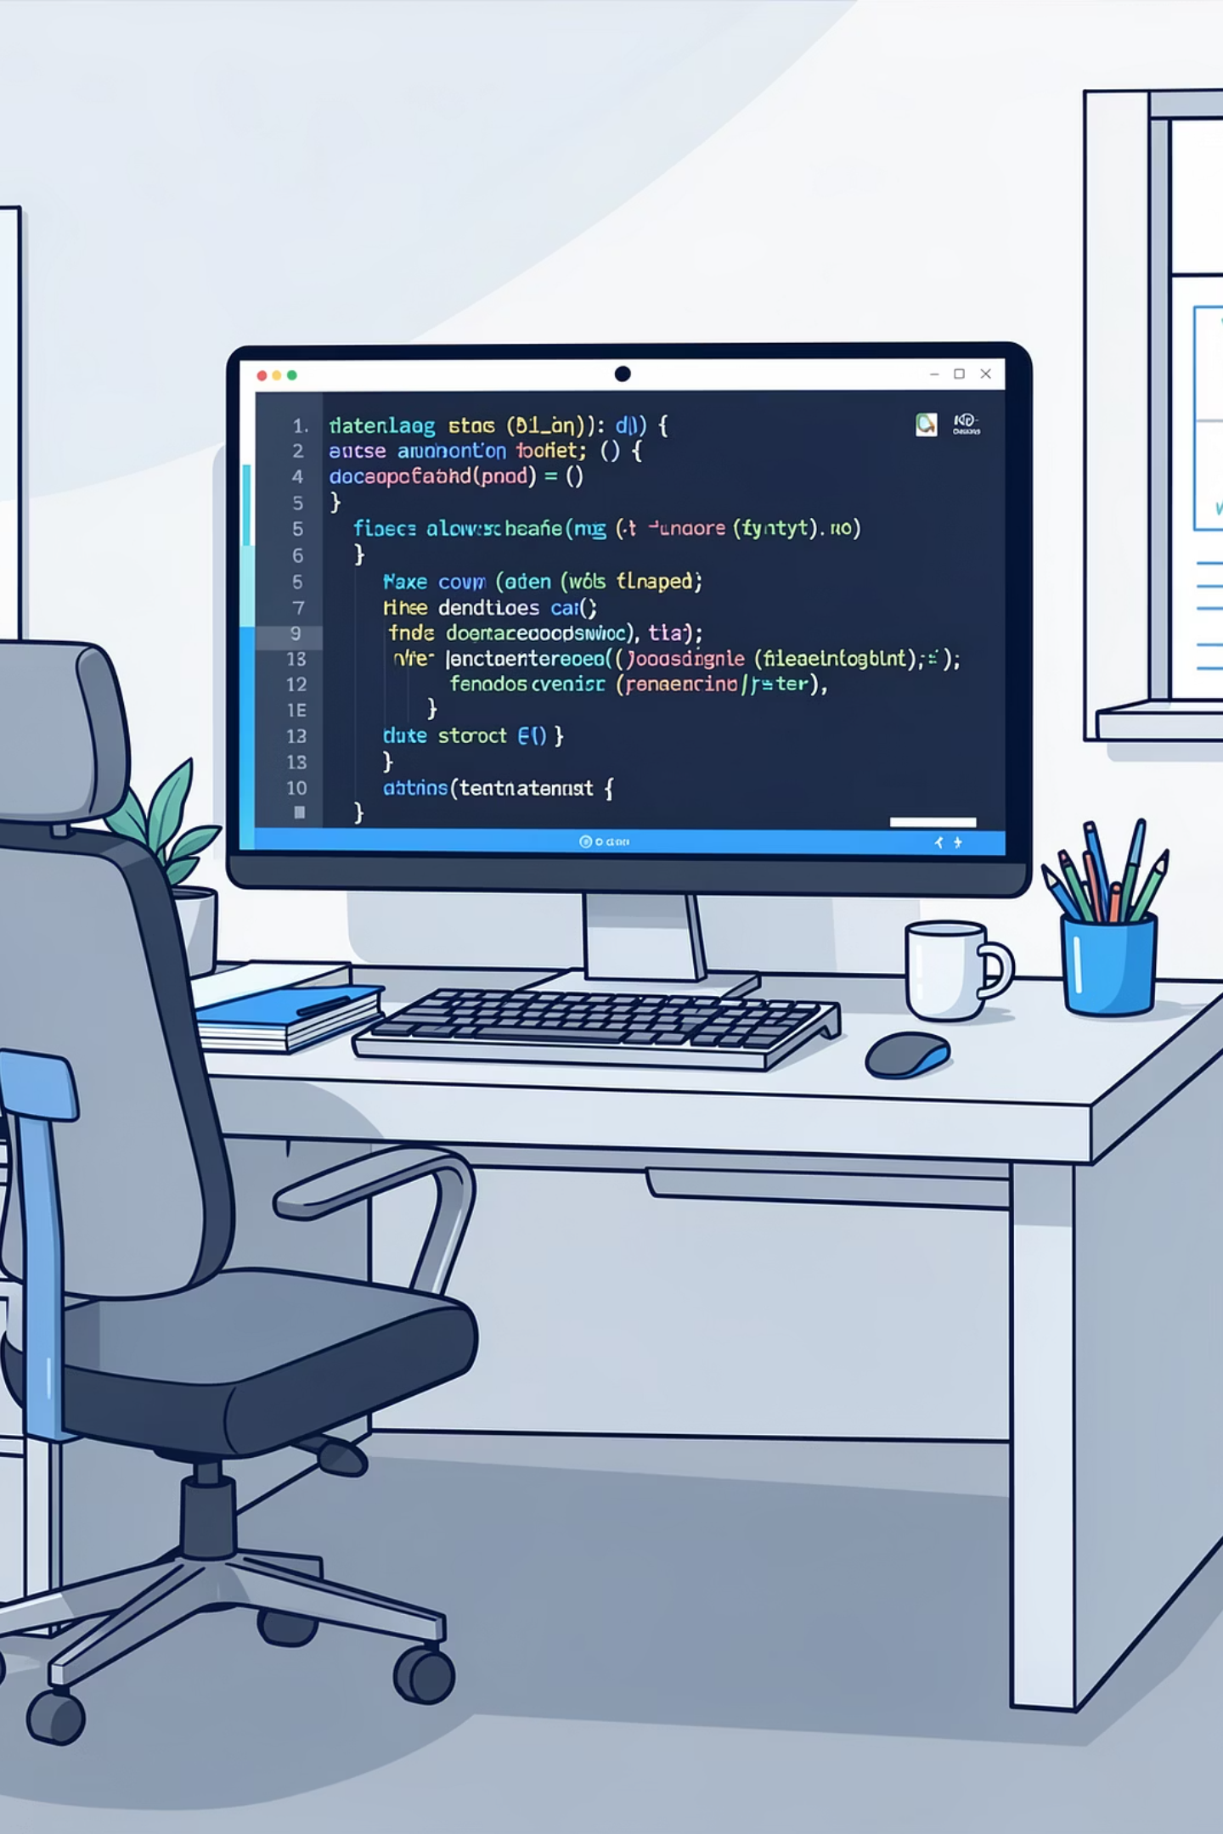
PYTHON ANALYSIS
Data Preparation Pipeline
01
Load & Explore
Import dataset, check structure, generate summary statistics
02
Clean & Standardize
Handle missing values, rename columns, verify consistency
03
Engineer Features
Create age groups and purchase frequency metrics
04
Database Integration
Connect to PostgreSQL for advanced SQL analysis

Slide 4
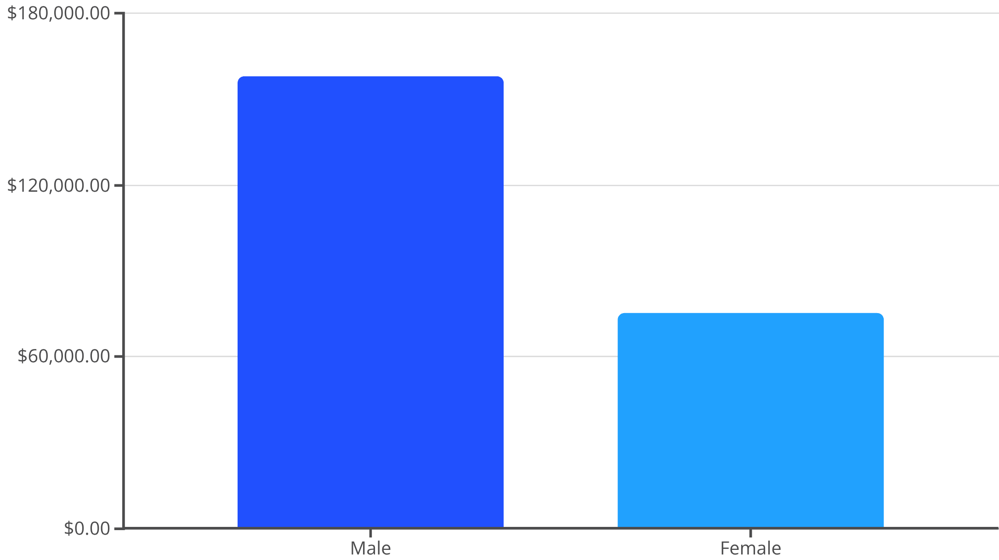
Revenue Insights
Gender Revenue Gap
Male customers generate 2x more revenue than female customers
Male Dominance
68% of total revenue
Opportunity
Expand female-focused campaigns

Slide 5
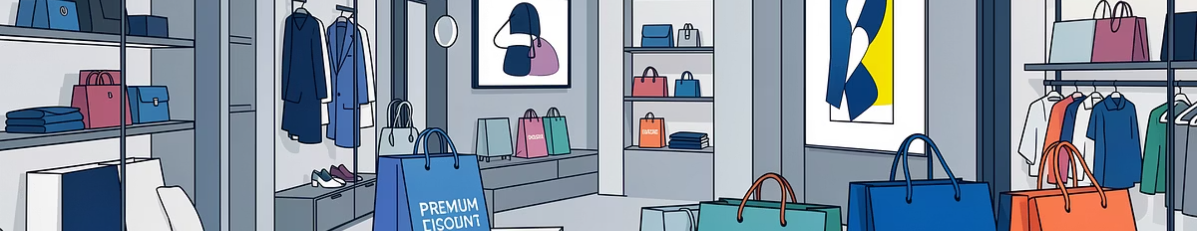
Smart Spenders
839 customers used discounts but still spent above average
Strategic Shoppers
Margin Opportunity
Discount-savvy customers maintain high purchase amounts
Balance promotional offers with profitability goals

Slide 6


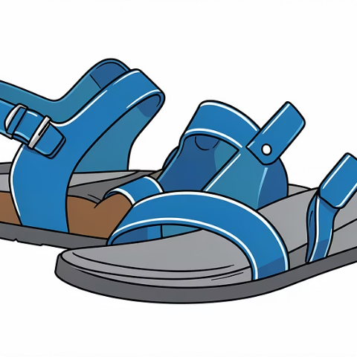


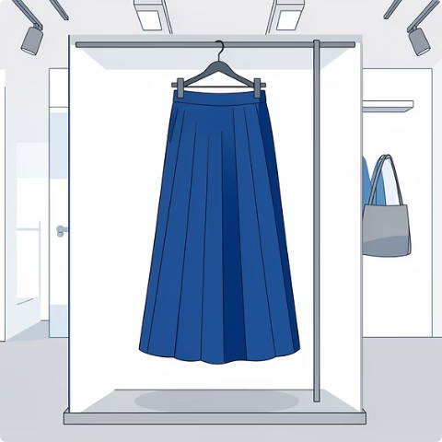
TOP RATED
Customer Favorites
Gloves
Sandals
Boots
Hat
3.86 rating
3.84 rating
3.82 rating
3.80 rating
Skirt
3.78 rating

Slide 7
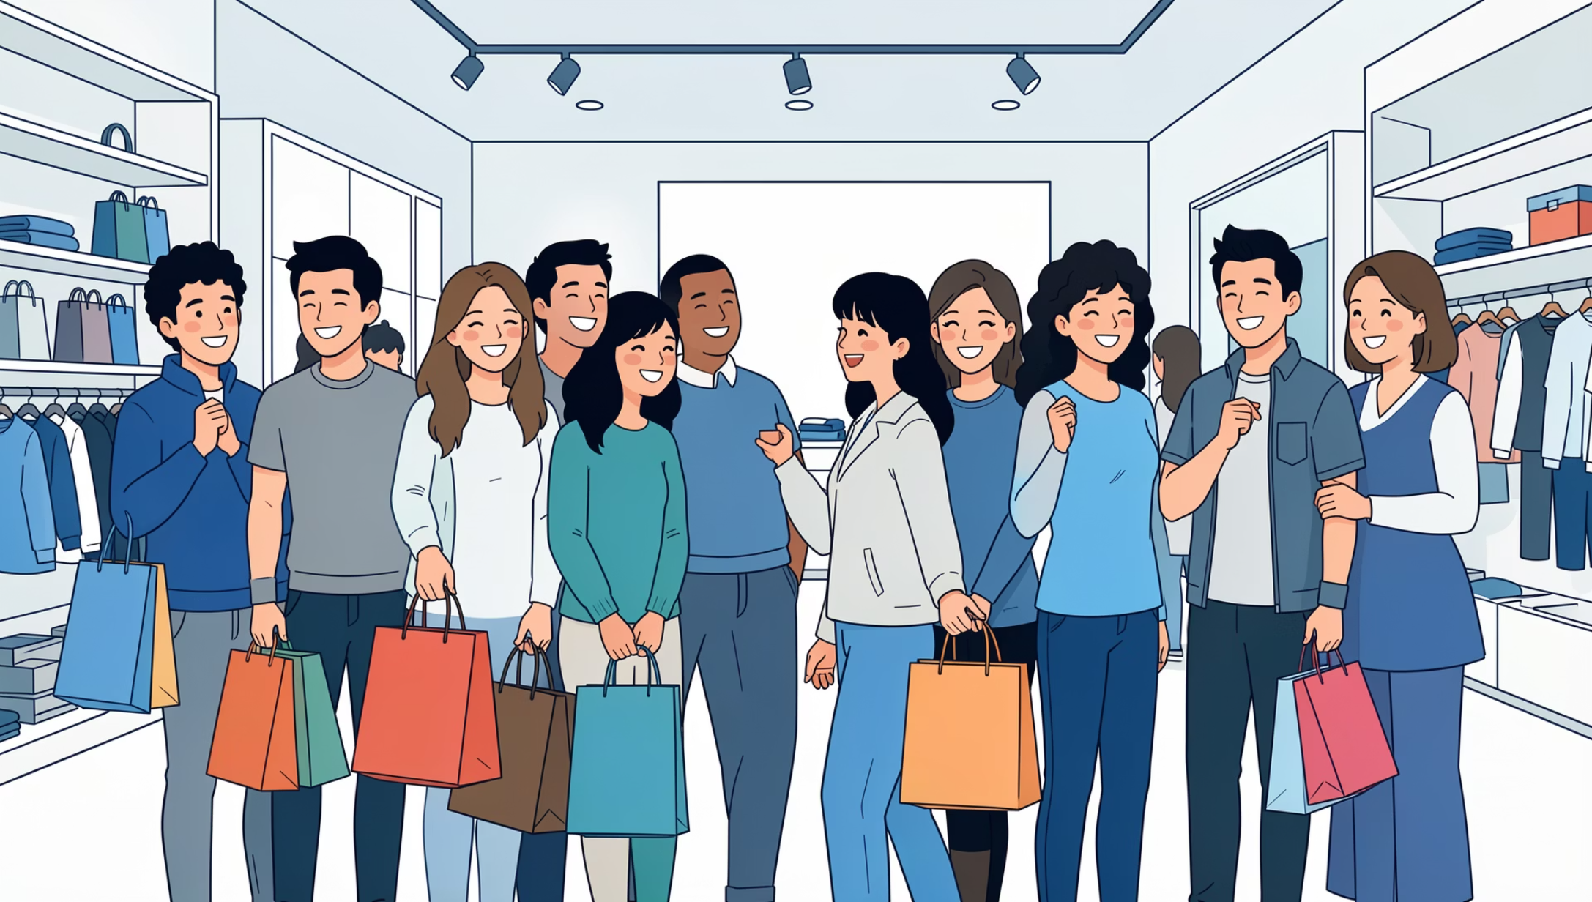
Customer Segmentation
Loyalty Distribution
Loyal: 3,116 customers (80%)
Returning: 701 customers (18%)
New: 83 customers (2%)
Strong base of repeat buyers with opportunity to convert returning customers

Slide 8
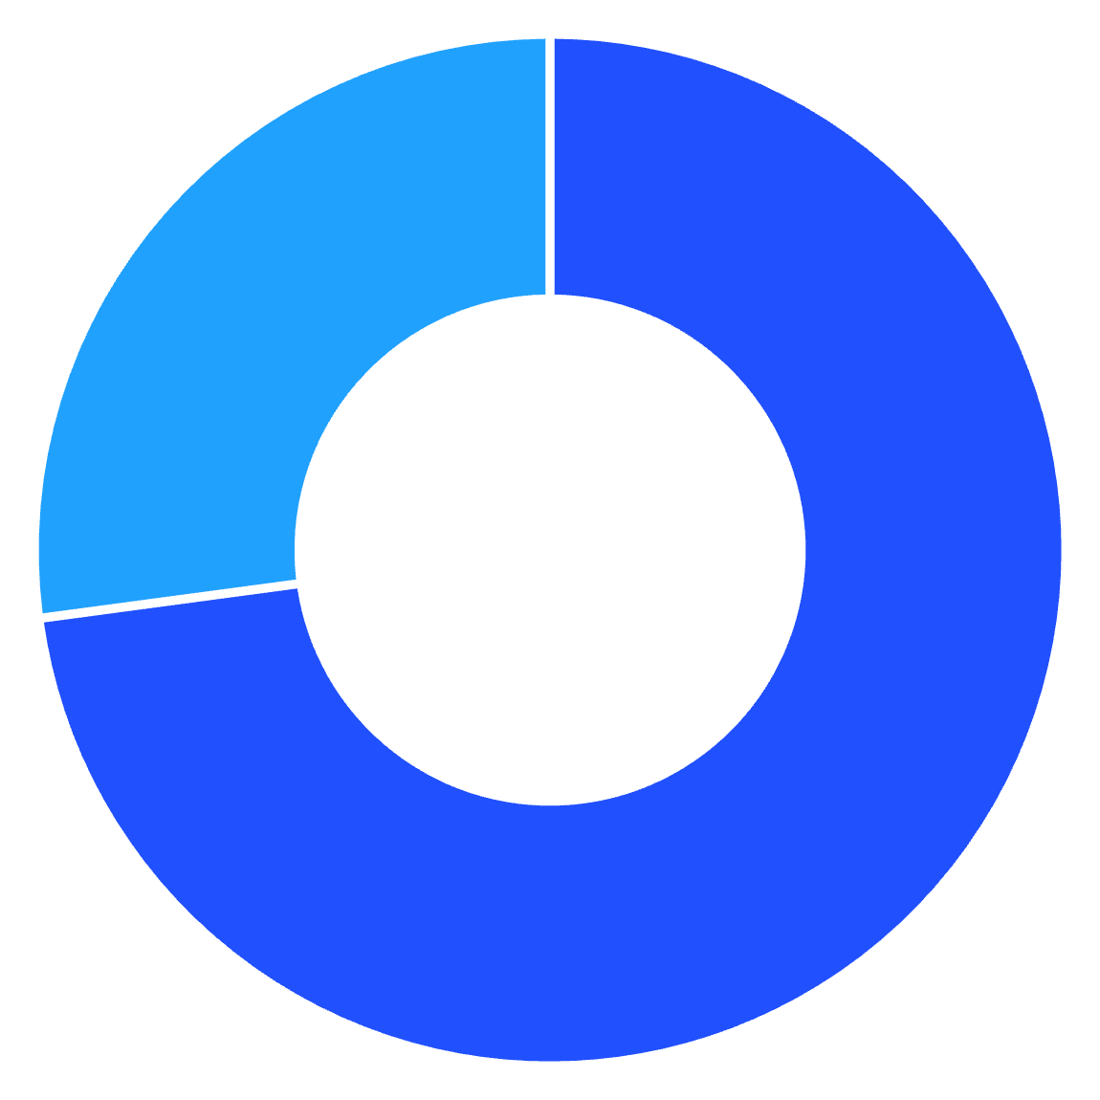
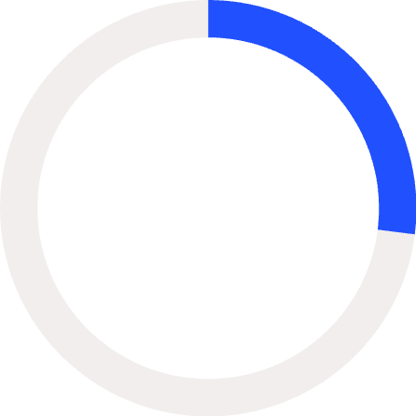
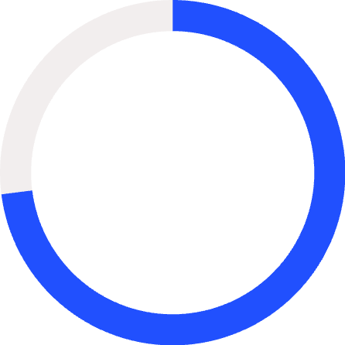
SUBSCRIPTION ANALYSIS
Subscription Impact
No
Yes
27%
73%
Subscribers
Non-Subscribers
Current subscription rate
Growth opportunity
Subscribers and non-subscribers show similar average spend ($59.49 vs $59.87)

Slide 9
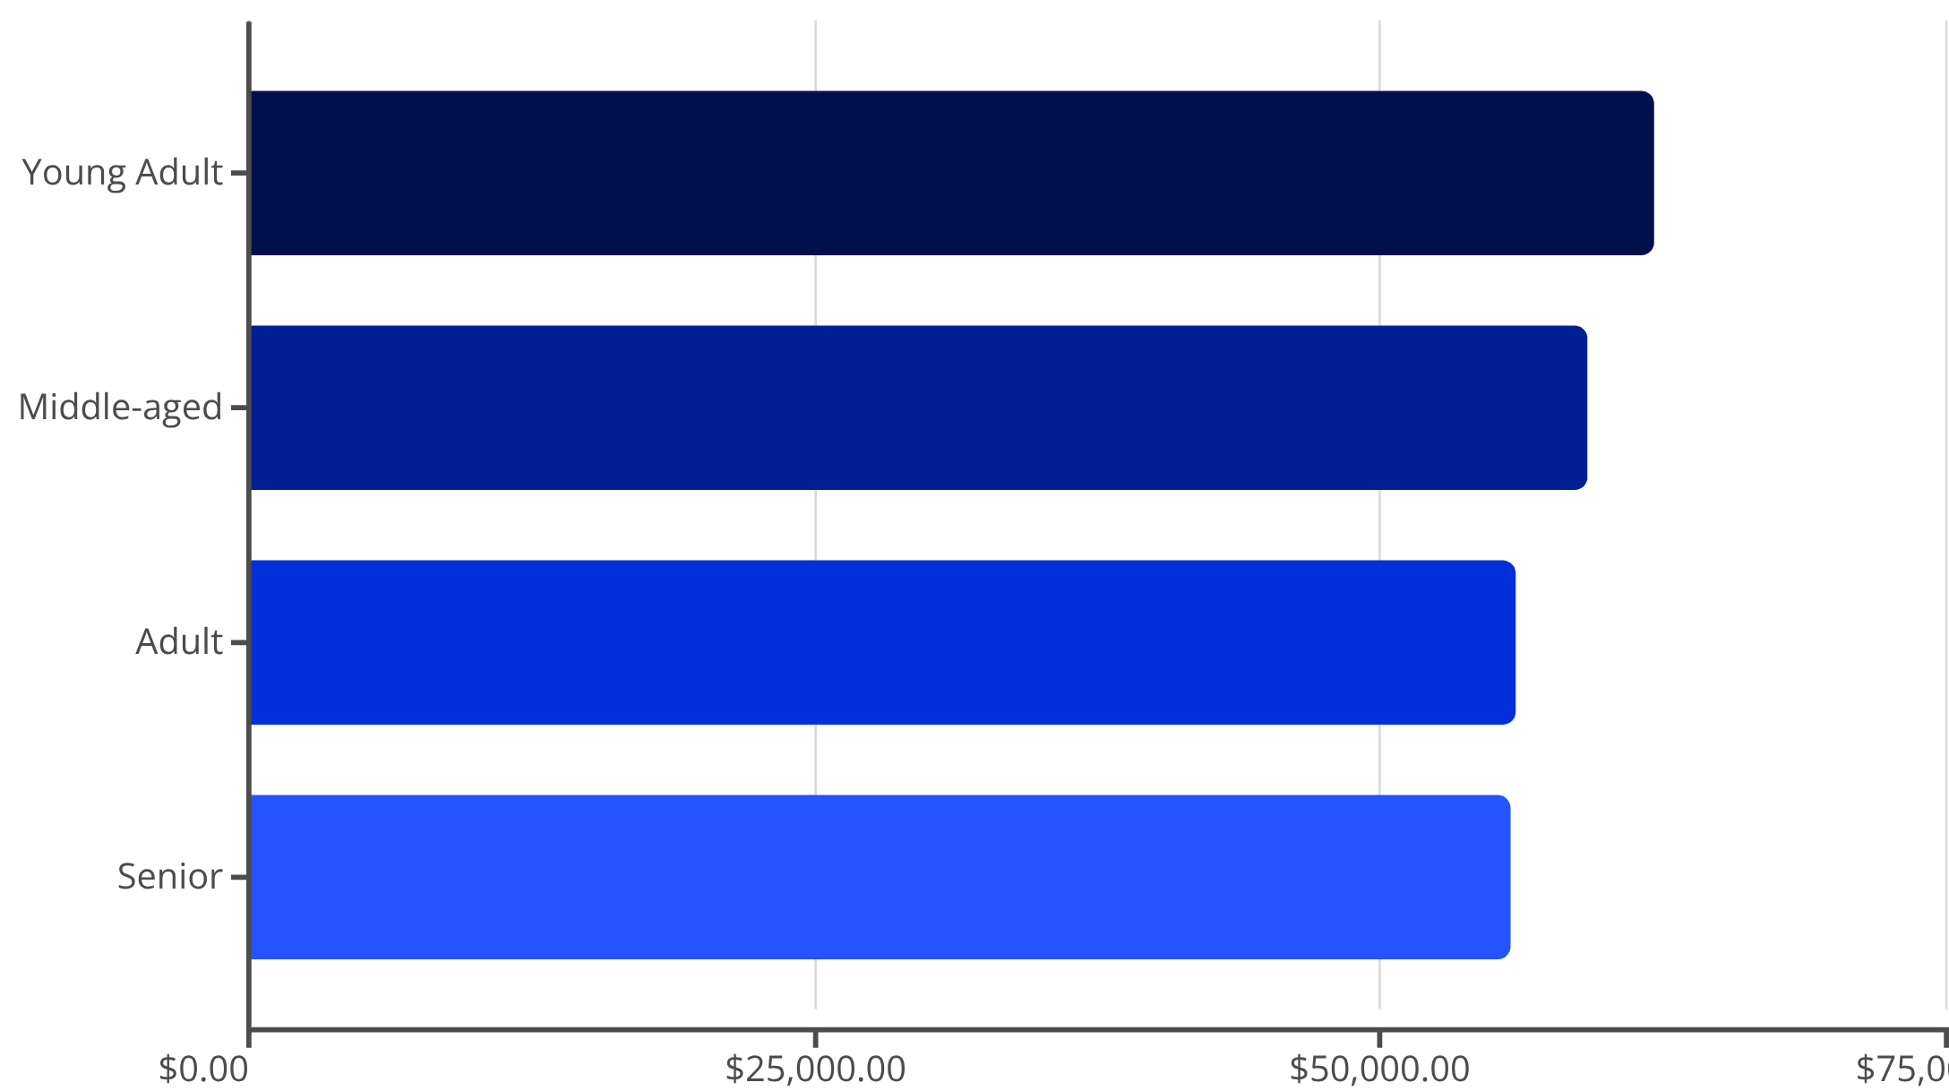
Revenue by Age Group
Balanced Demographics
Revenue distributed evenly across age groups with young adults leading
Young Adults
Highest revenue contributors
Cross-Generation
Appeal spans all ages

Slide 10
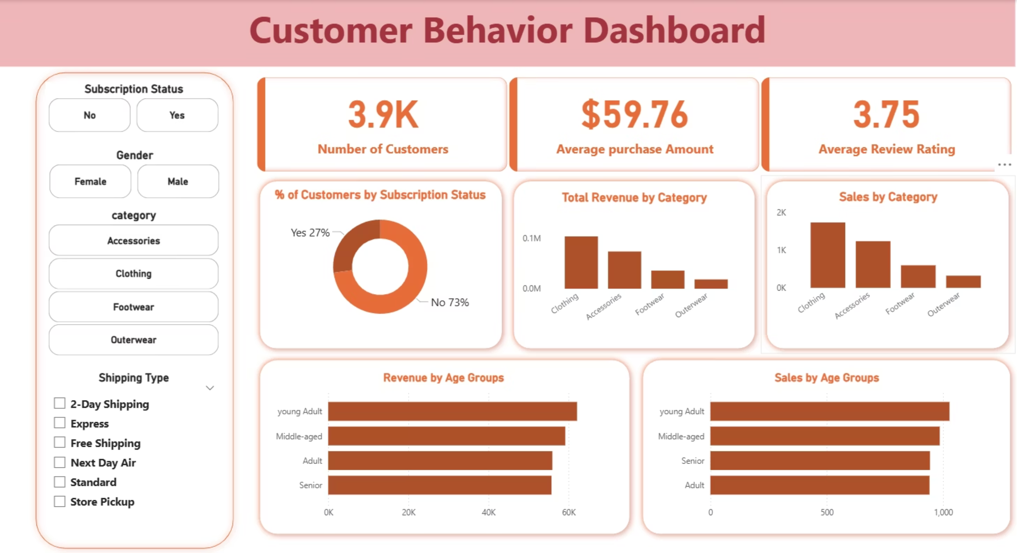

Slide 11
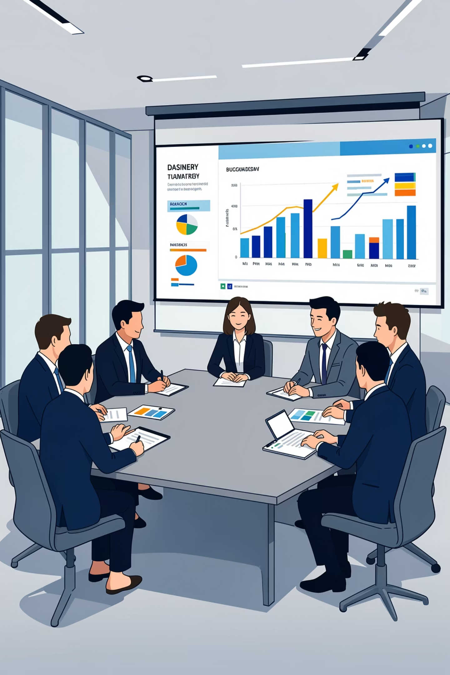
Strategic Recommendations
Boost Subscriptions
Promote exclusive benefits to convert 73% non-subscribers
Loyalty Programs
Reward repeat buyers to strengthen 80% loyal base
Review Discounts
Balance promotions with margin control
Targeted Marketing
Focus on high-revenue segments and top-rated products

